Slide 1
Cigna Case Study
By Bliss Joseph, Marney Lariviere, Pari Patel, and Serena Shah

Slide 2
The Patient Protection and Affordable Care Act
Also known as Affordable Care Act or Obamacare
Allowed insurance to be more available to individuals
Insurance based on age, geography, family size, and tobacco use
Difficult to make insurance available and affordable for all
Subsidies and Transitional Reinsurance Program
Notes:
The ACA made insurance more available to individuals by banning medical underwriting, which means that insurers were no longer allowed to obtain certain medical information about individuals. The only information that insurers can ask on applications are age, geography, family size, and tobacco use. Essentially, the ACA made it so that insurers could not deny coverage based on pre-existing conditions. But realistically, it is not possible for insurance companies to keep premiums low and not be certain about the risk level of the people they are insuring. Because of this, the Affordable Care Act wasn’t so affordable. With rising medical costs and more coverage under plans, insurance companies were forced to charge premiums that would only be affordable for the wealthy. As we can see, it is almost impossible to make insurance available and affordable to all without additional additional funding. As a result of this, the ACA established subsidies to help individuals afford insurance and the Transitional Reinsurance Program to help insurers afford the cost of high risk policyholders.

Slide 3
Background
After the Affordable Care Act was passed, insurance became more expensive.
ACA established the Transitional Reinsurance Program.
Transitional Reinsurance Program provides stability and lower costs for insurers.
Notes:
The transitional reinsurance program is a government run pool that is intended to socialize the risk of high-cost individuals. It does this by covering a specified percentage of the claims between a specified attachment point and cap. They raise the funds for this by taxing across health insurance markets on a per member basis. By covering a portion of claim costs, the government is taking some of the burden off of insurance companies and helping them to remain solvent.

Slide 4
Objective
Under the Transitional Reinsurance Program, what percentage of paid claims will be covered by the reinsurer?
Notes:
Our objective was to analyze whether or not the result of all the changes of to the rules governing the health insurance market in the U.S. were affordable.
Would Americans be able to afford health care in the future, and how would these changes impact the costs of the reinsurer?
Need to realize that in order to broaden the access to quality healthcare, we have to take extra steps to keep the costs down.

Slide 5
Member Plans
Risk | Plan | Deductible | Coinsurance | Total Out of Pocket
High | Gold | $1,000 | 20% | $4,000
Medium | Silver | $2,500 | 30% | $5,000
Low | Bronze | $4,500 | 40% | $6,000
Notes:
Before we consider the need for reinsurance, the members themselves are responsible for paying a certain percentage of their own claim. We had to first look at these amounts in order to determine the amount of claims that the company was responsible for after the member paid their part. We were given the data for each member plan, but not the risk level associated with each plan. We needed to determine the risk level in order to determine the severity and frequency of the claims that each plan would incur. So, we assigned a high risk level to the gold plan since its the plan with the lowest deductible and least amount out of pocket to the member. High risk people are expecting to have claims and in the case that they do get a claim, they would prefer to pay less out of pocket. We used similar logic to determine that the silver plan would be associated with medium risk individuals, and the bronze plan would be associated with low risk individuals.

Slide 6
How It Works
Year | Attachment Point | Reinsurance Cap | Coinsurance Rate
2014 | $45,000 | $250,000 | 80%
2015 | $70,000 | $250,000 | 50%
2016 | $90,000 | $250,000 | 50%
Notes:
The parameters of the reimbursement are outlined as followed:
This is how the government will provide reinsurance to the insurance companies
The attachment point is the amount that claims must exceed in order to be eligible for reinsurance, therefore the insurance company is responsible for paying up to the attachment point
The reinsurance cap is the maximum amount of reinsurance that the government will provide
The coinsurance rate is the percent of the claims that will be paid between the attachment point and the reinsurance cap
For example, for 2014, if a company had total claims that were below the cap, say $100,000, the amount of reinsurance that they would receive would be (100,000-45000)*.80
If the company had total claims that exceeded the reinsurance cap, say 500,000, the amount of reinsurance they would receive would be (250,000-45000)*.80

Slide 7
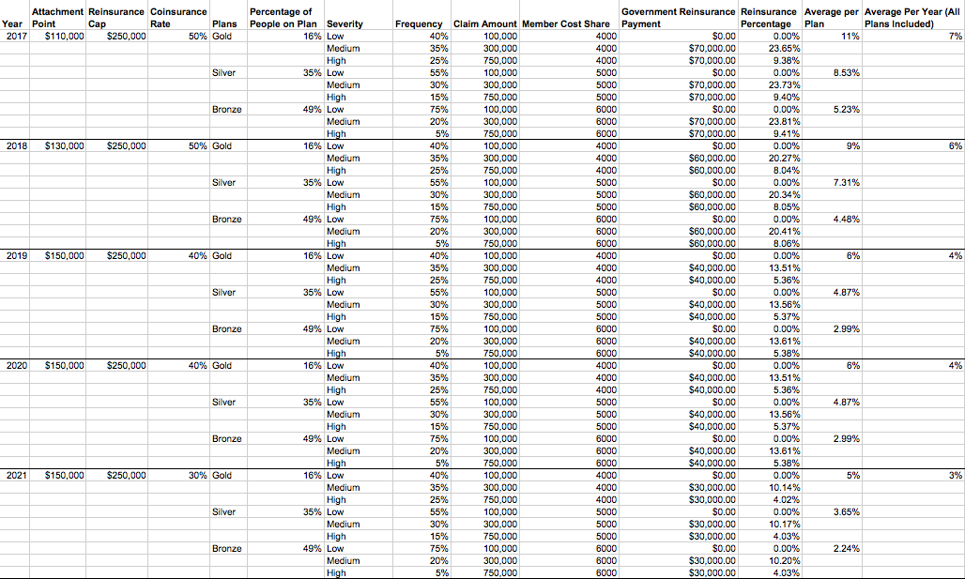
Notes:
Our goal in building this model was to find the percentage of claims that the reinsurer, which is the government pool, will be covering.
For our model, we made a couple of assumptions in order to create the distribution of claims and ultimately the percentage of these claims that would be reinsured by the government pool.

Slide 8
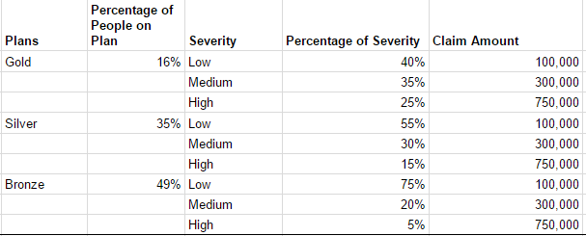
Notes:
We assigned amounts to each severity that a claim might experience -- $750,000 to the high severity level, $300,000 to the medium severity level, $100,000 to the low severity level.
We changed the distribution of claims based on their severity to the different plans. For example, people on the gold plan would incur low severity claims 40% of the time, medium severity claims 35% of the time, and high severity claims 25% of the time.
The silver plan was assigned with 55% probability of a low severity claim, 30% for a medium severity claim, and 15% for a high severity claim. Finally, the bronze plan was assigned 75% probability for a low severity claim, 20% for a medium severity claim, and 5% for high severity claims.

Slide 9
Calculations
Reinsurance Percentage = reinsurance payment / (claim amount - member cost share)
Government Reinsurance Payment = [min( claim amount - member cost share, reinsurance cap) - attachment point] * coinsurance rate
Notes:
In order to figure out how much each member paid, we used the data that was given to us about each plan. We then subtracted the amount that the member pays from the total claim amount in order to get the amount that the insurance company would be responsible for
The government reinsurance payment was calculated by taking the minimum of the amount that the insurance company is responsible for or the reinsurance cap and subtracting the attachment point and multiplying this by the coinsurance rate.
The percentage of claims covered by reinsurance for each plan is the reinsurance payment divided by the amount paid by the insurer. We then took the average of the percentages for each plan to get the overall reinsurance percentage for each year.

Slide 10
Limitations to the Model
Actual claims will show more variety
Distribution of claim severities may differ
Changes to people in plans
Notes:
Some limitations to this model are that actual claims will show a much larger variety rather than just our low, medium, and high severity claim amounts.
The distribution of the claim severities that we assigned can also end up being wrong. We made assumptions which may not align with real life perfectly.
Finally, we did not account for changes to people in these plans such as those who would switch plans throughout the years, or change their risk level but continue to stay in their current plan.

Slide 11
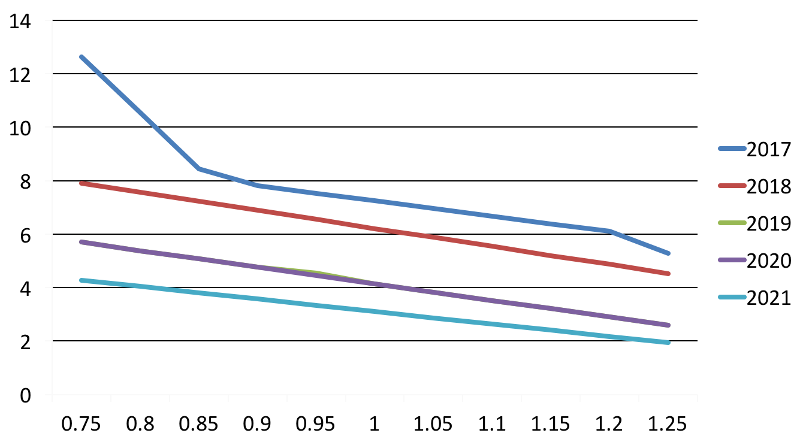
Attachment Point Sensitivity Test
Reinsurance Percentage
Percentage of Original Attachment Point
Notes:
We ran sensitivity tests in order to determine how the percentage of claims covered by the reinsurer would change as certain variables changed. We found that the reinsurance percentage was most sensitive to changes in the attachment point, coinsurance rate, and reinsurance cap. We would expect this because these variables directly affect the coverage amount in the calculations. We found that the reinsurance program was cushioned enough so that any fluctuation in claim amounts and distribution of plans did not impact the reinsurance coverage percentage. → what you mean cushioned?
Taking a look at this graph, its easy to see why the reinsurance percentage and the attachment point are negatively correlated. As the attachment point increases, this means that amount that the insurance company has to pay before the reinsurance even kicks in is increased. Thus, it makes sense why the reinsurance percentage would decrease. For example, in 2017, if the actual attachment point was 75% of the $110,000 that we predicted, then the reinsurance percentage would be 12.64%. Inversely, if the attachment point factor was 125% of the $110,000, then the reinsurance percentage would decrease to 5.82%. Also, in the data we were given to start, we saw that the attachment point over the years tended to increase. So, we’d expect that over time, the amount of the claims covered by this program are going to decrease.

Slide 12
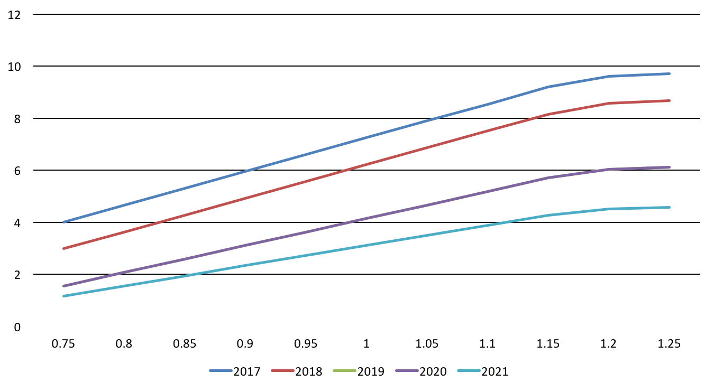
Reinsurance Cap Sensitivity Test
Reinsurance Percentage
Percentage of Original Insurance Cap
Notes:
We also discovered that the reinsurance cap and the reinsurance percentage of coverage from the program are positively correlated. An increase in the reinsurance cap correlates to an increase in the reinsurance percentage. For example, in 2017, if the actual reinsurance cap was 75% of the $250,000 that we predicted, then the reinsurance percentage would be 4.01%. If the actual reinsurance cap was 125% of the $250,000, then the reinsurance percentage would increase to 9.71%. This makes sense because as the reinsurance cap increases, the amount of claims that the reinsurance program agrees to cover increases. This implies that the total percentage of claims that the reinsurer will cover will increase.

Slide 13
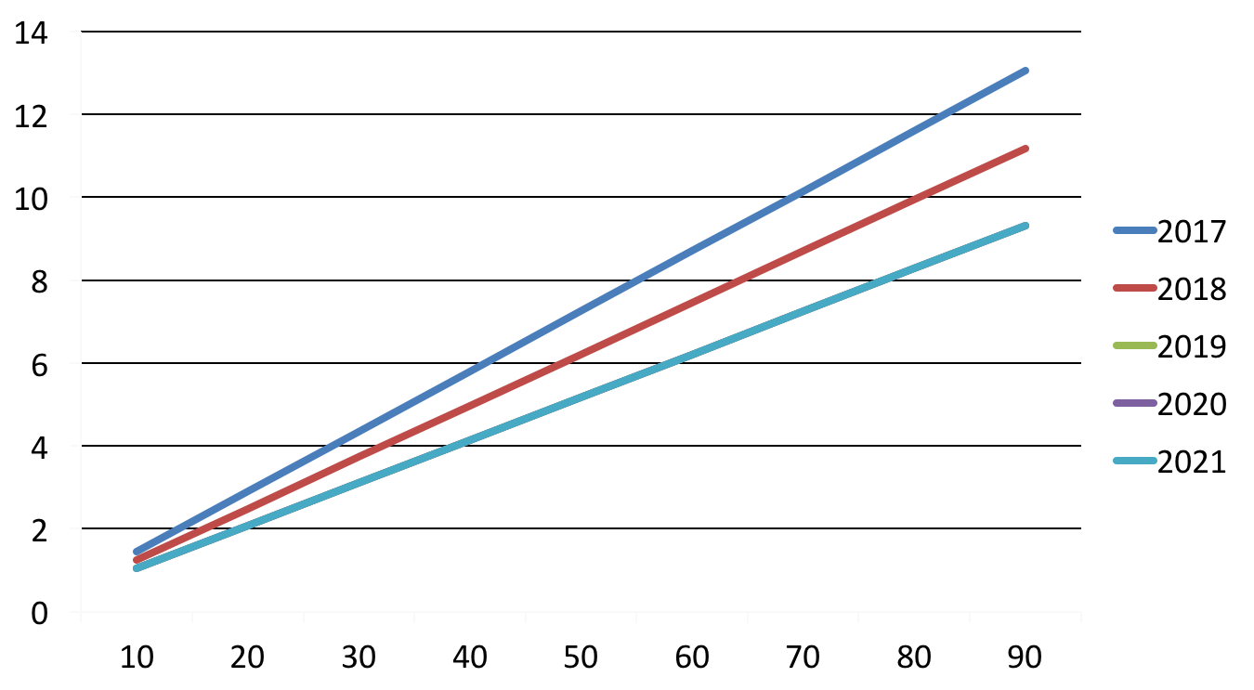
Coinsurance Rate Sensitivity Test
Reinsurance Percentage
Coinsurance Rate
Notes:
We discovered that the coinsurance rate and the reinsurance percentage of coverage from the program are positively correlated. As the coinsurance rate increases, the percentage of claims covered by reinsurance also increases. For example, in the year 2017, a coinsurance rate of 10% produced a reinsurance percentage of 1.45%. As the coinsurance rate increase to 90%, the reinsurance percentage also increased to 13.05%. This is due to the fact that as the coinsurance rate increases, the reinsurance is covering a greater amount, therefore the percentage of coverage by the reinsurer is higher. In the original data that we were given, we observed a trend that suggested the coinsurance rate will decrease as time goes on. Thus, we’d expect the reinsurance program to cover less and less of our claims each year.

Slide 14
Conclusion
Reinsurance will decline
Reinsurance amounts depend on attachment point, reinsurance cap, and coinsurance rate
Health insurance company should take extra precautions in order to have enough money to fund future claims
Notes:
If the trends continue as they have since 2014, we’re going to see continuous increases in attachment points and decreases in the coinsurance rate. This means that the reinsurance program will be covering less and less of the claims, therefore increases the burden on the company. If health insurance companies chose to remain with the same amount of business that they currently have, they will need to take other measures in order to be able to meet the obligation of paying the claims they incur. Health insurers could combat this decrease by increasing premiums for all plans, or changing the total out of pocket costs in order to cover their share of total claims.

Slide 15
Questions?
bliss.joseph@uconn.edu
pari.patel@uconn.edu
marney.lariviere@uconn.edu
serena.shah@uconn.edu

