Slide 1
Predictive Modeling Partial Withdrawal for Variable Annuity
Ruokun Liu and Shu-Hua (Edward) Liao
Sep. 9 2016

Slide 2
Table of Content
Introduction
Data Structure
Feature Engineering
Modeling
Objective
Frequency Model
Severity Model
Model Validation
Final Result
Conclusion

Slide 3
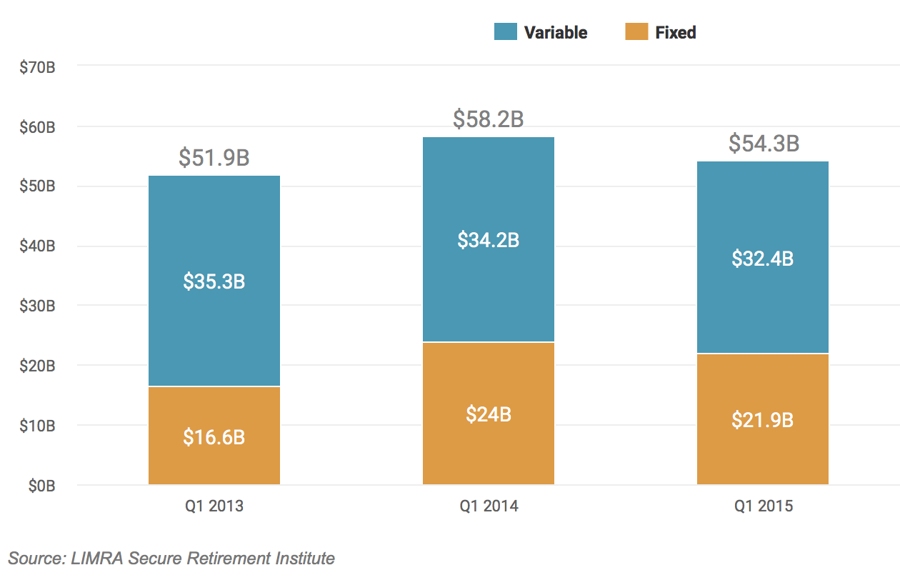
Introduction - Variable Annuity
Life Insurance / Savings unit-linked product
Used for retirement and other long term savings/income purpose
Offers different types of guarantees

Slide 4
Introduction - VA Guarantees
Guaranteed Minimum Income Benefit (GMIB)
Guaranteed Minimum Death Benefit (GMDB)
Guaranteed Minimum Accumulation Benefit (GMAB)
Guaranteed Minimum Withdrawal Benefit (GMWB)
Source: The Geneva Association

Slide 5
Introduction - GMWB
Is the combination of:
The Investment Account (Separate Account)
A basket of investment funds
Policyholders allocate premiums into the investment account
Limit the percentage of funds in the riskiest investments
Guarantees
Guarantee the policyholders to withdraw a specified percentage of the benefit base for a specified number of years
Guarantee Lifetime Withdrawal Benefit (GLWB)

Slide 6
Introduction - GMWB Life Cycle
Source: The Geneva Association

Slide 7
Introduction – Key Risks for Variable Annuity
Longevity Risk
Withdraw Amount Guarantees
Cash Refund
Market Risk
Minimum Rate of Return Guarantees
Behavioral Risk
People are irrational

Slide 8
Data Structure
All the data has to be processed in SQL server
All the relevant information based on client’s experience was given
The data has been grouped by the clients

Slide 9
Feature Engineering
Longitudinal Data
Capture individual/historical characteristics
Frequency Model:
Historical Percentage of Partial Withdrawal Frequency
Severity Model :
Historical Mean of Partial Withdrawal Rate
Historical Slope of Partial Withdrawal Rate

Slide 10
Historical Percentage of Partial Withdrawal Frequency
Example:

Slide 11
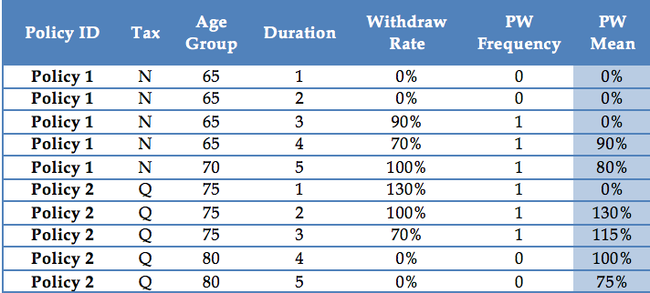
Historical Mean of Partial Withdrawal Rate
Example:

Slide 12
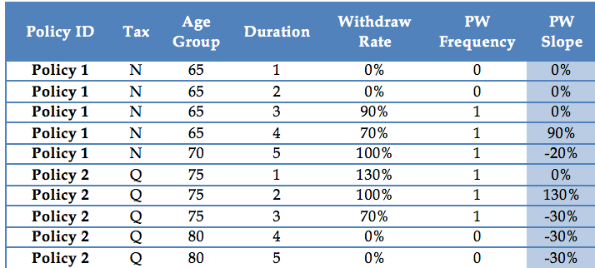
Historical Slope of Partial Withdrawal Rate
Example:

Slide 13
Model Design - Objective
To predict how much in total policyholders would do partial withdrawal in a particular year
Variables
Age
Tax
Duration
MaxWDs
Size
…
Frequency Model
Predicted Withdrawal Amount
Severity Model

Slide 14
Frequency Severity Modeling
Frequency Model
Data: Whole dataset
Response variable: Partial Withdrawal Frequency
Method: Logistic Regression
Severity Model
Data: Subset of whole dataset with Partial Withdrawal Frequency = 1
Response Variable: Partial Withdrawal Rate
Method: Linear Regression

Slide 15
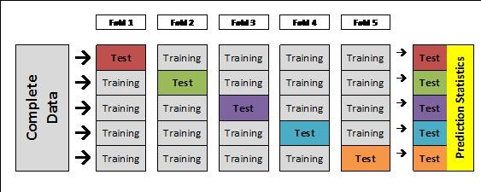
Model Validation
Model Validation Method
5 - Fold Cross Validation

Slide 16
Model Validation
Evaluation Metrics
Frequency Model: ROC Curve/ Area Under Curve (AUC = 0.94)
Severity Model: Root Mean Square Error (RMSE = 0.13 )
Final Prediction: Actual Over Expected (A/E = 100%)

Slide 17
Final Result
Our final result is the Predicted Dollar Amount of Partial Withdrawal:
Aggregated Final Result = (Predicted Partial Withdrawal Frequency) * (Predicted Partial Withdrawal Rate) * (Maximum Allowed Annual Withdrawal)

Slide 18
Conclusion
Being able to capture the pattern of Partial Withdrawal
Capture the behavioral risk
The combination of SQL and Revolution R
Importance of feature engineering for predictive modeling
More advanced statistical learning methods for actuarial science

Slide 19
Thank You!
Questions are welcome!

