Slide 1

2012 Goldenson Center Advisory Board Meeting
University of Connecticut
Department of Mathematics
College of
Liberal Arts and Sciences
August 24, 2012

Slide 2
Agenda
    Introductory remarks – Jay Vadiveloo
    National Retirement Satisfaction Index project – Dr. Mark Abrahamson, Executive Director - Roper Center, Gary Rohrig & Yang Li, actuarial science graduate students
    Risk management analysis of an Insurance Marketing Organization – Amelia Thacher, actuarial science undergraduate student
    Knowlton Trust Fund project – Ralph Urban, Attorney General’s Office, UConn & Gary Rohrig, actuarial science graduate student
    Text on ERM for Small & Medium-Sized Enterprises – Jay Vadiveloo
    Feedback from Advisory Board members

Slide 3
Introductory Remarks
    Highlights for 2011-2012 academic year
      Two U.S. patents awarded for RSS modeling technique in March 2012
      Two Ph.D students in actuarial science working on different aspects of RSS technique
      Media coverage for RSS in Sunday, May 2012 New York Times, UK publication of Life & Pension Risk and Risk & Insurance magazine
      ERM completed projects for International Association of Black Actuaries and two Insurance Marketing Organizations
      ERM work has prompted request for a text on ERM for Small & Medium-Sized Enterprises by Actex publishers and the Society of Actuaries
      Knowlton Trust Review project commissioned by UConn’s Attorney General’s Office
      Several joint projects with Towers Watson on SOA experience studies and a client long term disability A/E project
      Discussions on the creation of a National Retirement Satisfaction Index for the U.S.

Slide 4



National Retirement Satisfaction Index
End of summer presentation
National Retirement Satisfaction Index
A Presentation to the 2012 Goldenson Center Annual Advisory Board Meeting
Gary Rohrig & Yang Li
  August 24, 2012
Notes:
Good afternoon and welcome. <Slide>

Slide 5
Agenda
    Curriculum Vitae
    Project Overview
      Philosophy & Scope
    Project Background
    Index Development
      Definitions
      Benchmark
    Research Areas
    Conceptual Model
    RSE Indexing
    Financial Factors
    Research Areas - Non-Financial Variables
    Individual Index
    Project Timeline
    Acknowledgements
Notes:
Today we will be presenting our work on the National Retirement Satisfaction Index. Our agenda will follow the initial stages of the index’s research and development and I hope we can leave you today with a grasp of why would we try to create a retirement satisfaction index. <Slide>

Slide 6
Curriculum Vitae: Gary Rohrig, Actuarial Science M.S.
  Academic Background
    Applied Mathematics, B.S.
      Southern Connecticut State University - 2010
    Actuarial Science, M.S.
      University of Connecticut, Storrs - 2012
  Internship Experience
    edgeLab – GE/UConn Financial Accelerator
    Towers Watson – P&C, Software Actuarial Analyst
    Project Experience
    GE – Retail Credit Finance
    Portfolio Stress Testing Model
    UConn – Knowlton Trust
    Towers Watson
      Claims Cost Management
      Agent Modeling
      National Retirement Satisfaction Index
Notes:
We are both here today with a firm knowledge in Actuarial Science. We have a project background in a variety of actuarial based projects and we bring to this project a unique perspective on retirement as young yet forward-looking actuaries <Slide>

Slide 7
Curriculum Vitae: Yang Li, Actuarial Science M.S.
Academic Background
    Insurance, concentration Actuarial Science, B.S.
      Shandong University of Finance, Jinan – 2011
    Actuarial Science, M.S.
      University of Connecticut, Storrs – 2012
  Work Experience
    SunLife – 2012
Project Experience
    United Health Group
      Profitability Analysis of Health insurance Exchanges
    Goldenson Center
      National Retirement Satisfaction Index
Notes:
(Yang Introduction) <Slide>

Slide 8
Project Overview
    Problem
      Due to limitations in the current retirement preparedness indices, there is a need to reliably account for satisfied living in retirement
    Philosophy
      In order to give a full and positive picture of someone's level of satisfied living after leaving the work force, we will research, develop and implement a national index to accurately account for both financial and non-financial drivers related to retirement
Notes:
Measuring retirement needs is often an onerous task. To do this, you need to foresee a vast collection of probabilistic events with both financial and non-financial implications. And for most labor force members there is always the question of “am I saving enough for retirement?” Well, we would like to ask: is money the only road to retirement salvation or are there more than just dollars and cents that come into play in being a satisfied retiree? <Slide>

Slide 9
Project Overview (cont’d)
    Scope & Value
      Determine partnerships
        Idea was initiated by two members of the Advisory Board
        Current project is supported by the Goldenson Center, UConn’s Roper Center and Towers Watson’s Retirement Practice
        Project team consists of five UConn faculty members and five UConn graduate students under the direction of Jay Vadiveloo
      Develop a National Retirement Satisfaction Index (NRSI) which will be updated annually
      The findings of the NRSI will be publicly available and actively marketed
      The NRSI could lead to the development of an individual retirement satisfaction index
Notes:
Our project main objectives are listed here. Creation a national index is something that has been done before, but our unique approach will stand out from the rest and incorporate sound academic and mathematic principals. <Slide>

Slide 10
Project Background
    Existing national indices
      National Retirement Risk Index (Boston College)
      International Retirement Security Survey (AARP)
      Retirement Confidence Survey (Employee Benefit Research Institute)
    Others focused on specific areas
      Across Generations Retirement Income Survey (New York Life)
      Retirement Preparedness Survey (Merrill Lynch)
      Fidelity Retirement Index (Fidelity)
Notes:
Of course, we’re not reinventing the wheel when it comes to retirement benchmarking. Many institutions do a good job of providing a reasonable financial forecast to workers. But of course, there is room for improvement. <Slide>

Slide 11
Project Background (cont’d)
Issues With These Indices
They do not rely on national U.S. data | Retirement quality is relative to one’s state of residence
They capture only purely economic data | Retirement is also impacted by non-financial factors
Updates to the indices are typically done annually or less frequently | Retirement quality drivers shift on a frequent basis
They use arbitrary constraints that put people in an “at risk” category | Often describe an undesirable and unnecessarily gloomy picture of retirement
Notes:
Shown here are some of the main issues that we plan to address with our index. In designing the NRSI, we want to avoid becoming a happiness index and so we will try to keep in mind why we select the various factors affecting retirement outcomes and how significant they can be for satisfied retirement living. <Slide>

Slide 12
Index Development
    Definitions
    Retirement: The state of being retired
    Retired: An individual who has left the workforce from part-time or
    full-time employment and will not return to the full-time workforce; typically, one who has completed their working or professional career
    Retirement Satisfaction: A measure of one’s quality of life in retirement. Related but not equivalent to a “standard of living”
    Retirement Satisfaction Index: A scale to measure retirement satisfaction which is indexed to one’s income level
Notes:
So when we build our index, one of the first steps is to define who we are talking about. Retirement cannot apply to those who have never entered the workforce. These are the perpetually poor and the trust-fund kids that live off an inheritance and never earn a wage. But of those who have earned a salary or wage for many years in the middle of their life, there comes a point to change from earning and saving to collecting and enjoying life. <Slide>

Slide 13
Index Development (cont’d)
      Benchmark
    Retirement Satisfaction Equity (RSE): A measure of retirement satisfaction. The actuarial PV of equity in financial and non-financial factors in retirement
      RSE = Financial + Non-Financial Assets – [Financial + Non-Financial Liabilities]
      RSE is an extension of the accounting principal of Equity = Assets – Liabilities
      RSE allows us to incorporate non-financial drivers in a financial environment
      Quantifying these non-financial retirement drivers is where the majority of research lies
Notes:
To show a level of satisfaction, we first should think in terms of what it takes to be retired, and specifically do we have enough savings to pay out our future liabilities. But financial assets and liabilities only give weight to the account balance. Where our satisfaction measurement is unique is where we incorporate both financial and non-financial factors. We will describe RSE in more detail later. <Slide>

Slide 14
Research Areas
    Financial Factors
      Assets from savings, social welfare, real estate equity
      Liabilities from living expenses, loans, mortgage, out-of-pocket health expenses
        Our liabilities will represent the minimum needs for survival in retirement
    Non-Financial Factors
      Health Status: As health status declines due to aging and disease incidence, an increase in out-of-pocket medical expenses can result, increasing liabilities
      Adaptability: As acquired skills and knowledge help to generate income in working years, there is likelihood to increase future assets in retirement
      Financial Planning: The duration and extent of financial planning incorporates the benefits of compound interest which may substantially increase future assets for retirement
      Job Satisfaction: A dissatisfied work life in late career can drive many to retire earlier than their expected retirement age and thus decrease their assets
Notes:
We see financial factors purely as dollars in and dollars out. Projecting cash flows is a relatively easy task that is done by many other indices. But, to show how non-financial factors can be quantified we will use the economically accepted principal of opportunity cost. Here we can see the associations for our four selected non-financial factors. In a moment we will look more in depth at these four factors. But first, to better describe how our index will work let’s look at our conceptual model. <Slide>

Slide 15
Conceptual Model
Retired
Gender
Age
Mortality &
Non-financial factors
Time
Assets
Savings & Welfare
BASE RSE
Liabilities
Needs & Expenses
Demographics
Financial & Non-Financial
Assets
ADJUSTED RSE
Liabilities
Financial & Non-Financial
A.P.V.
Cohort
A.P.V.
Years until retirement,
Non-financial factors
&
Mortality
Occupation
Working
Notes:
This is our conceptual model. At the beginning of the model we select our cohort. These demographics are only limited to the variety of the data we have on hand. Our source of data is now secondary data but that may change in the future as the index gains a broader acceptance. <Slide>
Next we look at the retired group because here we ignore any future wage earning. Of course people may work part time beyond retirement to supplement their income, but the data points to a significant drop off in age of members in the workforce after retirement. <Slide>
Similarly, for the workforce we look at after retirement assets and liabilities but here we add on the earning element. The amount and duration of saving for retirement has a clear and compounding effect on your retirement asset base. <Slide>
Similarly, for the workforce we look at after retirement assets and liabilities but here we add on the earning element. The amount and duration of saving for retirement has a clear and compounding effect on your retirement asset base. <Slide>
When we can gather the information on how much a cohort has in terms of their assets, we can determine their future liabilities on a fixed annual estimate. This takes our baseline RSE value and adjusts it for non-financial factors. <Slide>
We can then take the actuarial present value of the assets minus liabilities and determine the level of RSE in retirement based on the retirement age of the individual. <Slide>

Slide 16
RSE Indexing
High Income
$1,000,000
50%
Constraints
Income Before Retirement
Income Replacement Ratio
Low Income
$50,000
80%
$500,000
Income In Retirement
$40,000
Retiree Income
$1,000,000
$900,000
$800,000
$700,000
$600,000
$500,000
Super-Satisfied
Retiree Income
$50,000
$48,000
$46,000
$44,000
$42,000
$40,000
$1,000,000
100%
100%
$50,000
100%
Satisfaction Index
$500,000
0%
0%
0%
$40,000
Bankruptcy
Key takeaway:
The boundaries of the index will be adjusted to the income level of the cohort
Notes:
The first thing we think of when looking at what we will have in retirement is how much did we have before retirement. Pre-retirement income is the best way to proxy this. In this example, we compare two hypothetical earners. Then, to each of them we assign a desired replacement ratio that is relative to their pre-retirement wealth. This can also be called a standard-of-living. The resulting scale comes from setting the zero-amount to this level of retirement income and the one-hundred-amount to be equal to the pre-retirement income. We call the gradient from zero to one hundred your Base Retirement Satisfaction Equity. <Slide>

Slide 17
Financial Factors – Baseline RSE
We will take this APV methodology and add to it the non-financial resources that are required in measuring retirement satisfaction
Calculate the baseline RSE for any given retirement year
    Project assets from savings and add to them other sources like Social Security
    Project basic living needs and basic expenses
  Adjust the baseline RSE by non-financial factors to achieve a final adjusted RSE
  Find a target retirement age based off of this methodology
Notes:
With all the moving parts to look at in retirement it’s easy to make a mistake. Whether it’s a prospective or retrospective point of view we want to avoid making un-necessary or unreasonable projections. As you can see retirement equity tends to accumulate with age but at the point where they exactly meet your baseline level of satisfied livings needs you have reached your target retirement age. <Slide>

Slide 18
Research Areas – Non-Financial Factors
    Health Status
      Out-of-pocket health care costs are a large financial driver for retirees
        Accounting must be done for the quality of life one has in retired years
        Quality Adjusted Life Years (QALYs) is a generally accepted health care assessment methodology that accounts for the difference in health states, possible disease interventions and expected outcomes of those interventions
        QALYs = life expectancy x quality of remaining years of life
    Adaptability
      Higher paying jobs increase wealth with higher paying salaries and increased savings and benefits
        Measurement of the value-acquired skills through working will show an increased asset level in retirement
        More skilled retirees tend to have more utility from their means to generate income and reduce liabilities in retirement
Notes:
Most seniors find out-of-pocket health expenses can drive their fixed budgets to the breaking point. But is the intrinsic value of good health captured by out-of-pocket costs? We want to account for the quality and value of healthy retired living and quantify its relationship to health status. And how do you capture the valve of a good education? Having a good education gives a retiree the capability to generate some alternative form of income in retirement through the use of skills they have acquired over their working life. This measure of adaptability is a layer of extra security beyond purely financial assets that we want to capture in our index. <Slide>

Slide 19
Research Areas – Non-Financial Factors
    Retirement Planning
      The duration and extent of planning has a compound effect on the financial asset base
        Having a financial cushion can effectively shelter one from shocks in retirement
    Job Satisfaction
      For many workers, early retirement is not solely a financial decision
        We may account for the effects of physical and mental stress at work as well as the desire to spend more time with family with an opportunity-cost approach
        This associated adjustment can then be used to quantify for the anticipated level of satisfaction gained or lost within an expected retirement age window
      A utility function is currently our methodology for adjusting job satisfaction RSE
        In the above example, we use a 50% factor to adjust the calculated RSE
        To proxy one’s level of job satisfaction, we will use occupation and national job rankings
Notes:
There is demonstrated evidence that financial planning gives any retiree the extra security of knowing what lies ahead and the tools to react when unexpected events arise. Financial planning not only gives the added assets from extra savings but it also adds value by giving someone extra sense of security and the tools necessary to navigate the uncharted waters of retirement. Many of us have anecdotal examples of someone we know that retired "earlier" than expected. Whether it was the new boss they hated or the desire to spend time with the family or just to watch TV on the couch at home workers decisions to leave the workplace are often on a personal level. Of course, if we worked forever we would be that much richer when we died but of course as the adage goes “you can't take it with you when you go.” So, to capture the notion of why anyone would forego potential wealth in exchange for mental relief of early retirement we use this methodology. <Slide>

Slide 20
Research Areas – Non-Financial Factors
In this example, the target retirement
age is 65
Retiring early – raises RSE
  Want to give a boost to RSE to attribute for the mental relief of early retirement
Retiring late – lowers RSE
  Want to show a penalty to RSE for the additional stress of being forced to retire late for undesirable financial reasons
Notes:
To illustrate the kind of utility function we may use to adjust for our non-financial factors, here we have an example of what someone who had poor job satisfaction would do. Observe that adjustments to RSE are relative to you expected retirement age, so if you have a dissatisfied work life but you retire at you age of retirement, you will not receive any adjustment to your RSE. But retirement outside of that target age demonstrates some personal reasoning and mental stressors that we will factor in. <Slide>

Slide 21
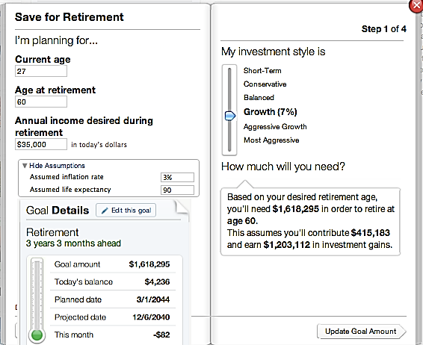
Individual Index
The NRSI could lead to the development of an individual retirement planning tool.
Incorporate the assumptions in the national Index
Make specific characteristics programmable from a client side
Make an simple yet elegant interface with features that improve the tools available already
Health Status:
Occupation:
Education:
Excellent
Actuary
Masters
Your Retirement Satisfaction Level is:
95
Above content furnished by Mint.com
For demonstration purposes
Notes:
When it is all put together, we will have a National Index that is updatable and publicly known. Gaining a broad acceptance of our methodologies on a national scale will probably grow a demand for an individual retirement measuring tool. This tool will flow easily from the national tool and give an added edge for workers and retirement planners who would like to determine what kinds of interventions could make for a more retired life. This doesn't exist yet and the market for such a product is wide open. <Slide>

Slide 22
Project Timeline
Research
Mid October 2012
Review
Late November 2012
Final
Report
Mid December 2012
Design & Testing
Late October 2012
Planning
We are here
Notes:
For such a large project the planning and research is the monster of the burden. But research is fully underway with the help of UCONN's Roper Center, a data repository that holds millions of public surveys. The team of 5 UCONN faculty members and 5 UCONN grad students working with the direction of Professor Jay and we have set tentative due dates for each of the future stages. <Slide>

Slide 23
Acknowledgements
Towers Watson
Jay Vadiveloo, PhD, FSA, MAAA, CFA – Project Director, Founder
UConn
Faculty
James G. Bridgeman, FSA, Associate Professor of Actuarial Science
Brian Hartman, PhD, ASA, Assistant Professor of Actuarial Science
Joseph Golec, PhD, Associate Professor at Finance Department
Richard Fortinsky, PhD, Professor of Medicine, Physicians Health Services Endowed Chair in Geriatrics and Gerontology
Garry Lapidus, PA-C, MPH, Director of Connecticut Children's Injury Prevention Center
Students
Tiran Chen, MS, Statistic and Financial Math
Chris Adams, MS, Actuarial Science
Stephanie Sollars, MS, Actuarial Science
Roper Center
Lois Timms-Ferarra
Mark Maynard
Mark Abrahamson
Notes:
The work on this project is mainly done twice a week as a team. We meet with the full team for a call-in on Wednesdays and on Fridays we hold a student meeting in the UCONN math building. This is when we discuss our areas of research and drive ideas forward on what the index is ultimately going to do. <Slide>

Slide 24

Thank you, your questions are welcome
Notes:
Thank you.

Slide 25
Appendix

Slide 26
Non-Financial Variables– Relationships
 | Retirement Planning | Adaptability | Job Satisfaction | Health Status | ∆ Time
Health Status | If health status declines, an increase in retirement financial liabilities may result | If learned interventions in health such as diet, exercise and disease preventions are in place, health will be positively impacted | If a job negatively impacts health (hard labor, disease) job satisfaction will decline | Fluctuates overall due to disease and intervention: Declines naturally with aging and accelerates near mortality
Job Satisfaction | If a job offers good work-force benefit packages, job satisfaction will increase | If a job requires highly adaptable workers and gives opportunity of advancement tends to increase job satisfaction | Insignificant in early career, but may stagnate or decline towards end of career (not a retiree factor)
Adaptability | The more knowledge of retirement options the more likely planning for a fully satisfied retirement will be | Builds in early life with collegiate and technical skill development, but achieves stasis after an attained level
Retirement Planning | Low in early career but increases steadily as years remaining in workforce diminish
Notes:
We still have to do with these non-financial adjustments to RSE. Specifically, how do these effects correlate to each other and how are they changing over time. Starting from the top-right we see how health status behaves as a function of time. Then moving to the left how job satisfaction, adaptability and retirement planning affect and are potentially affected by health status. <Slide>

Slide 27
Non-Financial Variables– Relationships
 | Retirement Planning | Adaptability | Job Satisfaction | Health Status | ∆ Time
Health Status | If health status declines, an increase in retirement financial liabilities may result | If learned interventions in health such as diet, exercise and disease preventions are in place, health will be positively impacted | If a job negatively impacts health (hard labor, disease) job satisfaction will decline | Fluctuates overall due to disease and intervention: Declines naturally with aging and accelerates near mortality
Job Satisfaction | If a job offers good work-force benefit packages, job satisfaction will increase | If a job requires highly adaptable workers and gives opportunity of advancement tends to increase job satisfaction | Insignificant in early career, but may stagnate or decline towards end of career (not a retiree factor)
Adaptability | The more knowledge of retirement options the more likely planning for a fully satisfied retirement will be | Builds in early life with collegiate and technical skill development, but achieves stasis after an attained level
Retirement Planning | Low in early career but increases steadily as years remaining in workforce diminish
Notes:
On the next level of the relationship matrix we observe that job satisfaction is a function of time relative to planned retirement age. From the previous slide on job satisfaction we looked at a 15 year window from 55 to 70 and used age 65 as our planned retirement age. Again, we see the inter-relationship between factors as job satisfaction is impacted by retirement planning and adaptability. <Slide>

Slide 28
Non-Financial Variables– Relationships
 | Retirement Planning | Adaptability | Job Satisfaction | Health Status | ∆ Time
Health Status | If health status declines, an increase in retirement financial liabilities may result | If learned interventions in health such as diet, exercise and disease preventions are in place, health will be positively impacted | If a job negatively impacts health (hard labor, disease) job satisfaction will decline | Fluctuates overall due to disease and intervention: Declines naturally with aging and accelerates near mortality
Job Satisfaction | If a job offers good work-force benefit packages, job satisfaction will increase | If a job requires highly adaptable workers and gives opportunity of advancement tends to increase job satisfaction | Insignificant in early career, but may stagnate or decline towards end of career (not a retiree factor)
Adaptability | The more knowledge of retirement options the more likely planning for a fully satisfied retirement will be | Builds in early life with collegiate and technical skill development, but achieves stasis after an attained level
Retirement Planning | Low in early career but increases steadily as years remaining in workforce diminish
Key takeaway:
Retirement satisfaction will incorporate 4 main inter-related factors
Notes:
Finally, we see adaptability and retirement planning. Knowledge is the link between these two. Between knowing what your options are and the way and amount of time you have them, retirement can be greatly affected. And like job satisfaction, as time to retirement decreases the degree of retirement planning grows inversely. By retirement age, most if not all workers have planned some kind of retirement plan either with or without professional help. <Slide>

Slide 29
Risk Management Analysis of an Insurance Marketing Organization
Amelia Thacher

Slide 30
Introduction
Senior at the University of Connecticut
Interned at Milliman
  Summer of 2011
  Spring of 2012
  Health Segment
Interned at Cigna
  Summer of 2012
  Individual and Family Plans Pricing
How I got Involved
Honors Thesis

Slide 31
Students Involved
Jaclyn Bogensburger
  Graduate student
  Works at Deloitte Consulting
Lu Ma
  Graduate Student
  Works at Prudential
Jai Gangwani
  Graduate Student
  Works as a Business Intelligence Developer in Indianapolis
Brian Abrahamsen
  Senior at UConn
  Interned at The Hartford and Cigna

Slide 32
Agenda
Company XYZ Background
Phase I: Mission Statement
  Surveys
  Fall Meeting
Phase 2: Market Intelligence Database
  Agency Surveys
  Aggregate Results: Market Intelligence Database
Moving Forward
Q & A

Slide 33
Company XYZ: Background
Founded in 1986
Insurance Marketing Organization (IMO)
20+ Carriers
50+ Agencies
  $250m+ per year in life insurance sales
  $1b+ per year in annuity sales
Run by selected board members who are all participating agents

Slide 34
XYZ: Services
To Agents
  Advisory
  Access to distribution channels
  The ability to consolidate sales
    Higher commission level
  Relationships and connections
To Carriers
  More agency attention

Slide 35
XYZ: Challenges
Competition
Pressure from carriers for agency growth
Pressure to differ from the normal IMO
Expense pressures
General lack of growth due to decreasing agency importance

Slide 36
XYZ: Business Strategy
Develop a clear mission statement
Provide an ongoing feedback loop
  Between carriers and agents
  Create improvements from both sides
Distinguish from other IMOs so more than just a “Commissions Club”

Slide 37
Phase I: Mission Statement
Goal: Provide a detailed mission statement for XYZ.
Process
  Poll member agencies and carriers for mission statement input
  Compile responses
  Meet with the board
  Create mission statement

Slide 38
Member Agency Survey
What should the vision of XYZ be?
What’s working and what’s not working?
How can XYZ enhance its value to both the member and the carriers?
What are competitors doing that XYZ should replicate?

Slide 39
Survey: UConn Students’ Job
Listened in on surveys
Took notes on responses
Selected important and reoccurring points

Slide 40
Survey: Key Responses
More direction needed
Stress the importance of communication among agents and carriers
Focus on growth
XYZ should be a leader in innovation, technology, image, and more
Security in XYZ name from all facets

Slide 41
Fall Meeting
Met with the board members
Went over survey responses
Decided final mission statement
Discussed next steps

Slide 42
Mission Statement
“XYZ is dedicated to reign banded together by highly regarded, independent entrepreneurs unifying under one name, to share both the challenges and successes of the insurance industry. XYZ is committed to being the industry’s consummate leader: known for the integrity and quality of its life insurance producers and financial planners; recognized as best in class for providing its leading entrepreneurs and knowledgeable agents with the most innovative and excellent products, services, and solutions; helping them meet and exceed customer and partner needs for providing the highest level of security, protection, and financial planning; and a leader in providing meaningful contributions to our communities.”

Slide 43
Phase II: Market Intelligence Database
Goal: To create a user-friendly model that can be updated each month to provide important carrier information through the aggregation of agency profile surveys.
Process:
  Create an excel based agency profile survey
  Send out surveys and receive responses
  Create model (MID) to bring in responses and aggregate the information to provide important feedback for carriers and agencies.

Slide 44
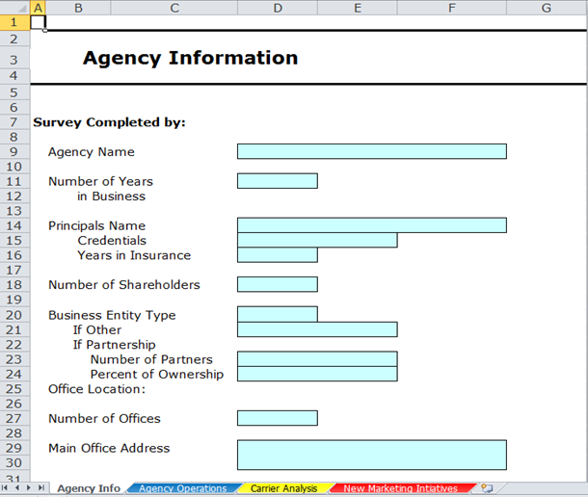
Agency Profile Survey: Agency Info

Slide 45
Agency Profile Survey: Agency Info
Basic information on agency
Location for filter
Salaried staff information
Succession planning information
  Does the agency have succession planning?
    Death
    Disability
    Retirement
  Would the agency be interested in XYZ wide succession planning?

Slide 46
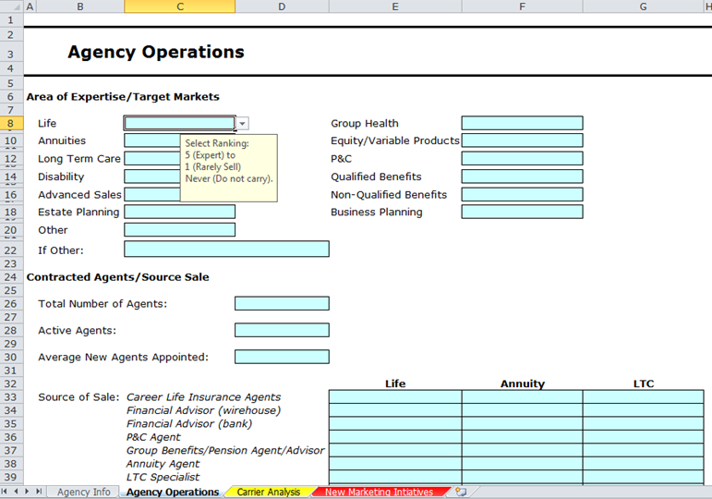
Agency Profile Survey: Agency Operations

Slide 47
Agency Profile Survey: Agency Operations
Area of expertise & where sales are made
  5 (expert) to 1 (rarely sell)
  Connect carriers with agents who sell a certain type of product more so than another
Number of agents for filter
Systems/technology/marketing used
  Suggest certain systems/technologies based on common usage
  Track marketing strategies with sales

Slide 48
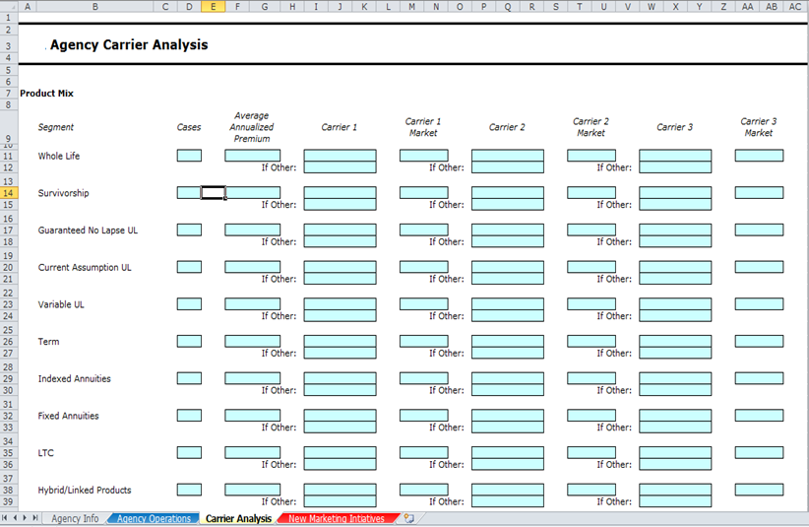
Agency Profile Survey: Carrier Analysis

Slide 49
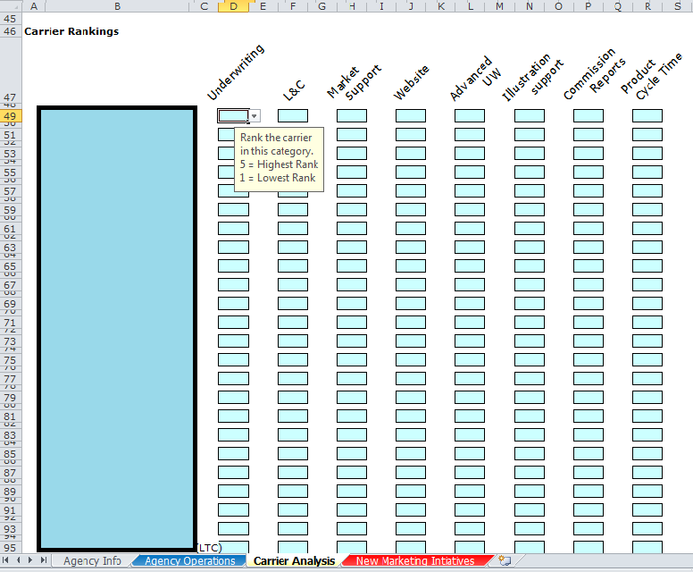
Agency Profile Survey: Carrier Analysis

Slide 50
Agency Profile Survey: Carrier Analysis
Product Mix
  Number of cases sold
  Premium received
  Preferred carriers
Carrier Rankings
  5 (highest rank) to 1 (lowest rank)
  Many different sections
  Numerical

Slide 51
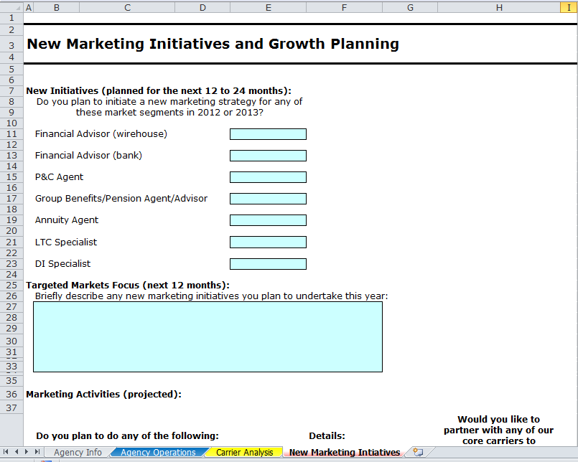
Agency Profile Survey: New Marketing Initiatives

Slide 52
Agency Profile Survey: New Marketing Initiatives
Planned marketing strategies by segment
Planned marketing strategies overall
  Mass mailings
  Email campaigns
  Web meetings
  Etc.
Reinsurance pool interest

Slide 53
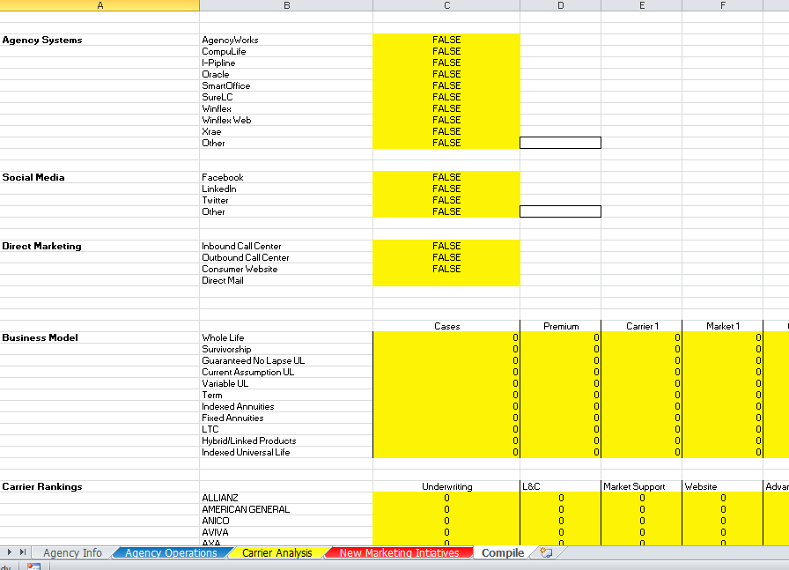
Agency Profile Survey: Behind the Scenes

Slide 54
Market Intelligence Database
Directions
Flexible Filters
  Location
  Agency Size
Significant Results
Easy to Update

Slide 55


Slide 56
Market Intelligence Database
Directions
Flexible Filters
  Location
  Agency Size
Significant Results
Easy to Update

Slide 57
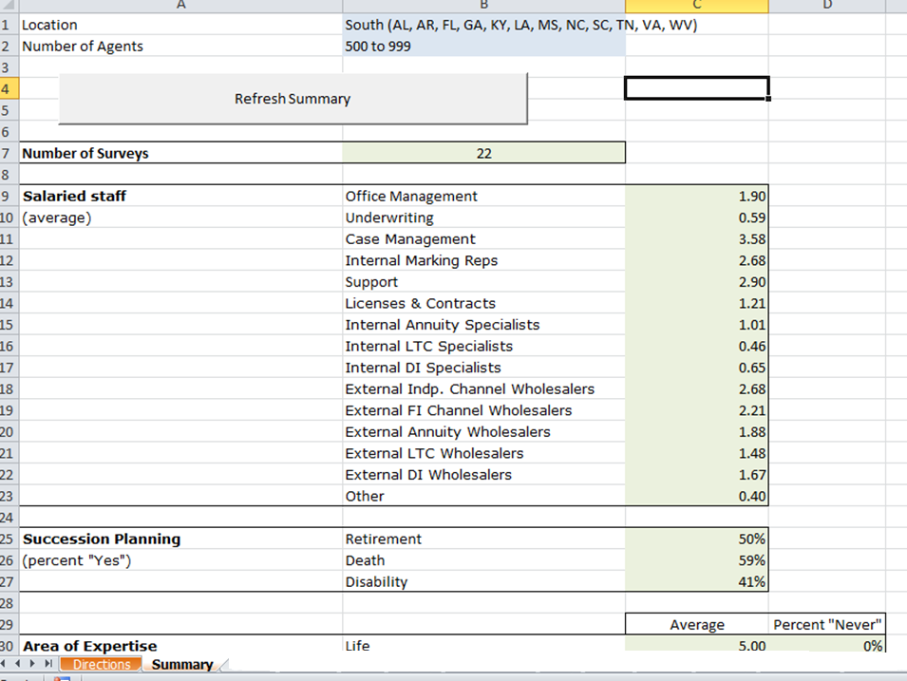

Slide 58
Market Intelligence Database
Directions
Flexible Filters
  Location
  Agency Size
Significant Results
Easy to Update

Slide 59
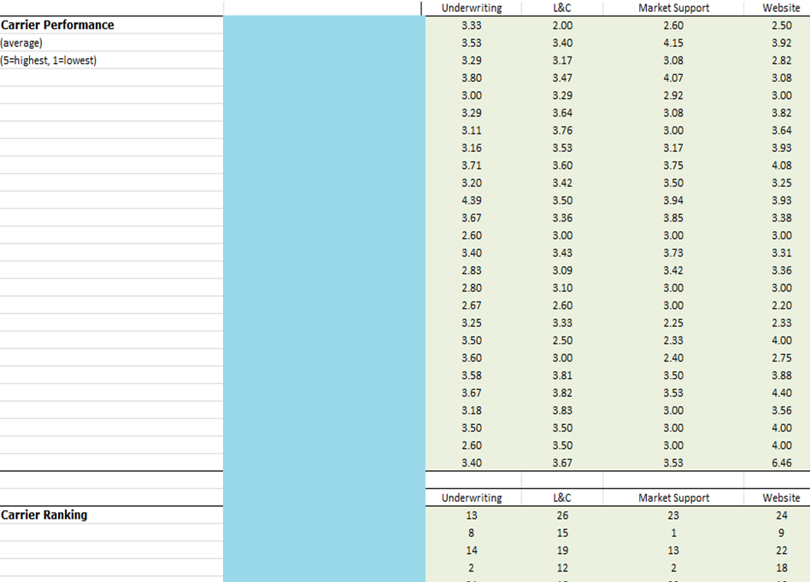

Slide 60
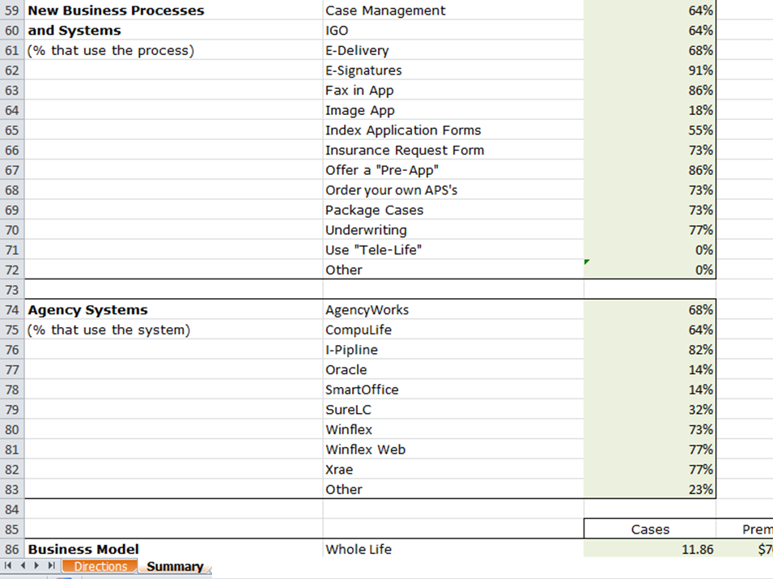

Slide 61
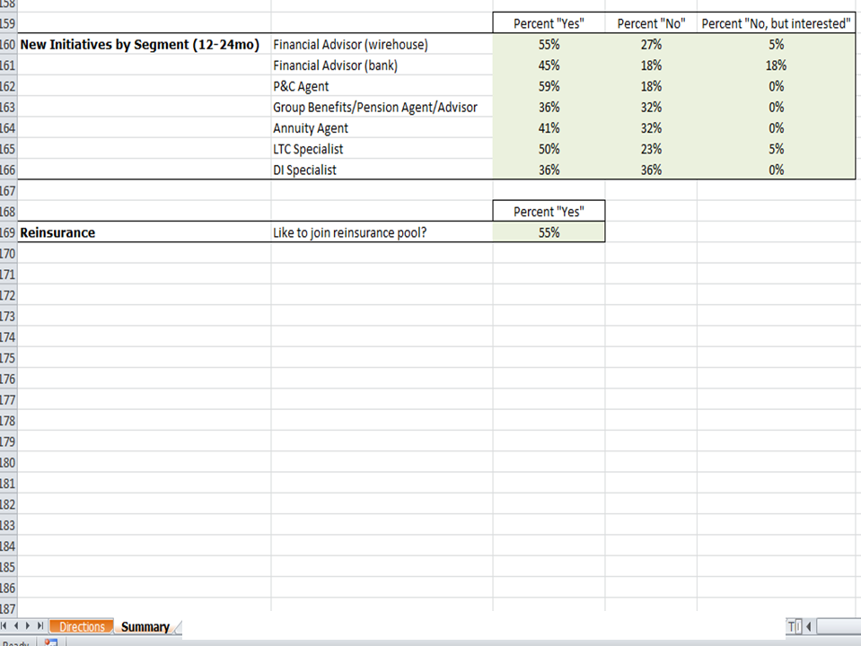

Slide 62
Market Intelligence Database
Directions
Flexible Filters
  Location
  Agency Size
Significant Results
Easy to Update

Slide 63
Moving Forward
Monthly updates of the MID
Reports to carriers and agents featuring what’s working and areas to improve
Overall better communication

Slide 64
Project Challenges
Phase I
  Leveraging many opinions
  What’s working vs. needed improvement
  Softer research than I’m used to
Phase II
  Technical difficulties
  Inconsistent responses
  Anticipating user error
Overall
  Sometimes out of my comfort zone
  High level of responsibility

Slide 65
Thank You!
Goldenson Center for Actuarial Research
Other Students Involved
Jay Vadiveloo

Slide 66
Questions??

Slide 67
Millard Knowlton Trust
2012 Summary
2012 Goldenson Center Annual Advisory Board Meeting
Ralph Urban, Assistant Attorney General
Gary Rohrig, Actuarial Sciences Graduate Student

Slide 68
Agenda
Summary of Fund in 2012
Factors Affecting Future Value
Conceptual Framework and Model
Analysis of Fund Projection
Scenario Analysis
Recommendations
Deliverables

Slide 69
Summary of Fund in 2012
Balance is approximately $775,000
UConn is the remainderman
Trust agreement stipulates
  UConn students receive full scholarship for up to 4 years
  Non-UConn students receive $3,000/year for up to 4 years
  Vocational students receive $1,000/year for up to 4 years
Knowlton family attorney feels that UConn is “driving the bus” in terms of the availability of the Trust money

Slide 70
Factors Affecting Future Value
Unknowns for family tree
  Family tree as of 2012
  Family growth rates
    Fertility rate
    Survival rate until reproductive age
    Survival rate until college age
  Age at reproduction
  Age at start of college

Slide 71
Factors Affecting Future Value
College enrollment rate
College decision rates (UConn vs. non-UConn)
UConn annual rate of tuition and fee increase
Annual Fund’s management taxes and fees
Annual rate of return on invested Trust funds
Year of death of last survivor, Jessica Dell Warren

Slide 72
Factors Affecting Future Value
What terminates the Trust?
  Trust runs out of money
  21 years following the death of Jessica Dell Warren
    UConn receives the remaining balance
What determines the remainderman value?
  Contingent upon the year of death AND the expected value of the Trust funds
How can we determine the remaining trust money?
  Scholarships disbursements deplete the trust balance
  Need to forecast future disbursements and investment gains against the likelihood that the trust is still active

Slide 73
Conceptual Framework
Knowlton Descendants
Three generations of births in family tree
College Enrollment
Deciding to attend UConn /
non-UConn / Vocational schools
Trust Expenditures
Inflating costs of attending UConn
Extending to the final disbursement years

Slide 74
Conceptual Model
Knowlton Descendants
by Generation
Second
lx~44
Third
lx~88
First
lx=22
Initial Cohort of family tree with child-bearing potential
Children of initial cohort
Grandchildren of
initial cohort

Slide 75
Conceptual Model
Enrollment Module
Knowlton Descendants
No College
UConn
Non-UConn
Vocational

Slide 76
Conceptual Model
Expense Module
number of years
Full Scholarship
$3,000/yr
$1,000/yr

Slide 77
Analysis of Fund Projection
We expect that the Trust will terminate due to lack of funds and there will be no remainderman balance
The trend of increasing UConn fees depletes the Trust
There is more money coming to UConn than non-UConn
Trust payouts are strongly tied to:
  College decision rates
  UConn tuition and fee rates
  Utilization rates of the family

Slide 78
Scenario Analysis – Baseline
Mortality | Basic, Select | USSOA 1975-80
Births/family member | 1.8327 | US Census Bureau
Age of first reproduction | 23.98 | US Census & CDC
Age at utilization | 18.00 | ---
Avg years of utilization | 3.00 | ---
Gross enrollment & utilization ratio | 75% | ---
UConn decision rate | 50% | Trust Disbursements
Non-UConn group decision rate | 40% | Trust Disbursements
Vocational group decision rate | 10% | Trust Disbursements
UConn Fees | Schedule | UConn
UConn annual in-state rate increase | $941 | UConn
Non-UConn group annual funds | $3,000 | Trust Agreement
Vocational group annual funds | $1,000 | Trust Agreement
Average annual fund fees | $6,000 | ---
Interest rate - fund earnings | 6% | ---
Nominal rate | 4% | ---

Slide 79
Scenario Analysis – Assumptions
 | Baseline | Scenario 1 | Scenario 2 | Scenario 3
 | Observation based on best current assumptions and data on hand | Reduced UConn benefits and stationary non-UConn fees | Stationary UConn benefits and increased non-UConn fees | Reduced UConn benefits and increased non-UConn fees
Gross enrollment & utilization ratio | 75% | 75% | 75% | 75%
UConn decision rate | 50% | 50% | 50% | 50%
Non-UConn group decision Rate | 40% | 40% | 40% | 40%
Vocational group decision rate | 10% | 10% | 10% | 10%
UConn fees | Schedule | $18,000 | Schedule | $10,000
UConn annual in-state rate increase | $941 | $0 | $941 | $0
Non-UConn group annual funds | $3,000 | $3,000 | $10,000 | $10,000
Vocational group annual funds | $1,000 | $1,000 | $5,000 | $5,000

Slide 80
Scenario Analysis - Findings
 | Baseline | Scenario 1 | Scenario 2 | Scenario 3
 | Observation based on best current assumptions and data on hand | Reduced UConn benefits and stationary non-UConn fees | Stationary UConn benefits and increased non-UConn fees | Reduced UConn benefits and increased non-UConn fees
Final active year | 2024 | 2039 | 2018 | 2043
Expected remainder bal | $ 0 | $ 167,351 | $ 0 | $ 151,595
Expected payout to UConn | 730,333 | 776,485 | 620,039 | 537,841
Expected payout to non-UConn | 65,890 | 87,986 | 168,275 | 347,622

Slide 81
Recommendations
Preserving any chance of a remainderman value requires a reduction of UConn benefits
  A flattened rate of $15-$20k per year would increase the
  Trust age
Preventing any legal action may require increasing the benefits to non-UConn students
  Doubling the non-UConn benefits would not change the remainderman payout unless the UConn benefits were reduced
Optimally, a reduction of UConn benefits and stationary
non-UConn benefits
  The chance of a remainderman is increased
  Most of the Trust disbursements still come to UConn in the form of tuition and fees
  College enrollment will still be incentivized toward UConn

Slide 82
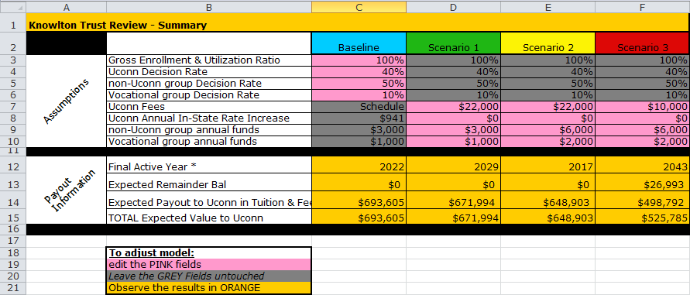

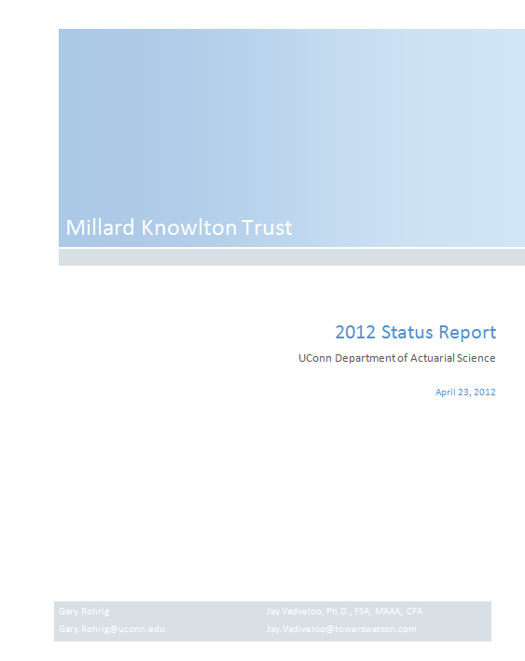
Deliverables
Model
Report

Slide 83
Thank you
Your questions
are welcome

Slide 84
ERM text for Small & Medium-Sized Enterprises
    Approached by Actex publishers to write text
    No such text currently exists in the ERM literature
    The SOA has expressed an interest in funding this text from their 2013 research budget
    Articles will be contributed by experts in the field, both practitioners and academicians
    Likely that this book could become a required text for students following the SOA ERM track

Slide 85
Potential Topics for text on Small & Medium-Sized Enterprises (SME’s)
    Underlying principles governing ERM for SME’s
    Overview of SME’s in the U.S.
    Differences/similarities between ERM principles for start-up SME’s, SME’s in business for a few years and established SME’s
    In-depth ERM analysis of some key SME business sectors based on actual case studies
    Regulatory environment for SME’s and impact on failure rates of SME’s
    Steps involved to undertake an ERM analysis for a given SME sector, including measuring and tracking results
    General ERM principles and methodologies for large corporations which can be adapted for SME’s
    Best practices to create a vibrant and growing SME environment in the US and the value of establishing a risk management culture for SME’s

