Slide 1
Mass Mutual Case Study
April 7th, 2017
Cole Irwin, Maria Johnson, Jadyn Wu, Qilong Chen

Slide 2
Introduction

Slide 3
Ideal aspects of Target Date Mutual Funds
Simplicity
Affordability
Evolve with changing consumer needs
Difficulties in adopting this in an insurance product
Target Consumer: Middle Market

Slide 4
Targeting Consumers

Slide 5
Meet The Middle Market Consumer
General Facts
50 million households
Ages 24-60
Annual Income between $25,000 to $99,000
Notes:
Always seen as a whole,
However,
The most diverse and varied consumer market.
Leads to being the least understood

Slide 6
Meet The Middle Market Consumer
Issues Raised
Diversified Needs/ Concerns
Misconceptions about Insurance
Notes:
These consumers are the most varied group, risk wise, and thus have many factors to be taken into account.

Slide 7
Misconceptions about Insurance
Expensive
Complicated
Low Awareness
Notes:
Has misconceptions about insurance
Believes it is too expensive, they cannot afford it
Too complicated
Is not worth is for them
people who prefer to buy products that are neither very cheap nor very expensive.

Slide 8
Approaching the Middle Market Consumers
Increase advertising to captivate with middle market
Show that the product is affordable
Adjusting to the varying needs of the middle market
Partnership with companies to increase reach to more customers
Health Trackers
Employers

Slide 9
Underwriting and Application

Slide 10
Underwriting
Focus on different risk factors
Children/Dependents
Medical History
Smoker/Drinker
Work/Profession
Behavioral Assessment
Notes:
Focus on different risk factors
Children/Dependents
Work field/Profession
Current/Recent Prescription Drugs
Smoker/Drinker
Behavioral Assessment

Slide 11
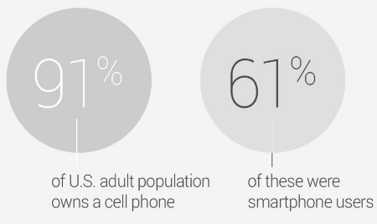
Means of Distribution
- Questionnaires
- Online Application
- Mobile App
Notes:
Permission to access information. simplified application process, one that doesn’t require a medical exam

Slide 12
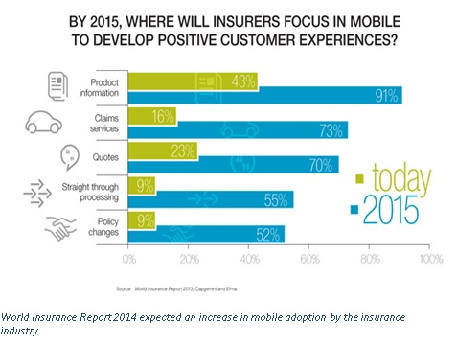
Mobile Application
Secure (card information + fingerprint)
Accessible on the go
Very user friendly
Offer a review area to get customers’ opinion for our policies and services
Offer small benefits for customers using our
application
Notes:
J- Lessons learned across financial services
Property and casualty policyholders routinely file claims, pay premiums, request quotes and receive policy information through digital channels.
direct agents chat can be offered.

Slide 13
Product MassMutual Complete Coverage(MMCC)

Slide 14
Highlights of MMCC
Level Premium
Locked in premium rate for life
Tailored Coverage
Interchangeable at year end
Personal Point Program
Tailored saving
Reinforced asset protection

Slide 15
Coverages
Disability
Long Term Care
Dependents
Retirement
Unemployment
Critical Illness
MMCC
Notes:
affordable over the lifespan
With level premiums, the policyowner is effectively paying premiums in advance—paying now to prevent increasing premiums in the future. With level premiums, you pay more in the beginning, but the premium costs average out over time so that you can end up saving money.
Security – you know in advance what your premiums will be so you can guarantee you can afford it in the future.
A fixed price – the premium doesn’t increase annually and remains the same till the policy ends (except for modest yearly increases relating to inflation)
The flexibility to increase your cover (and your premium) if you choose
Level premiums also suit you if you’re young and look at getting a head start on a long-term policy. While you may pay more initially, you could end up saving a substantial amount over time.
Your personal “go to” account for the reserves generated by excess annuities
This money goes to a fund earning guaranteed interest rate for life
Accessible anytime, through our app and online!
If you wish to have disposable money rather than a savings account, you can log on and transfer excess money into your own hands to spend.

Slide 16
Personal Points Program
Disability
Long Term Care
Dependents
Retirement
Unemployment
Critical Illness

Slide 17
Personal Points Program
Disability
Long Term Care
Dependents
Retirement
Unemployment
Critical Illness

Slide 18
Insurance Perspective
Limitation
- Cap on amount consumer can raise
- Waiting period
Additional Services
- Travelling coverage as bonus for loyalty consumers
(free 3 weeks, redeemable anytime)
- Other short term insurances and products

Slide 19
Roger’s Life Through MMCC

Slide 20
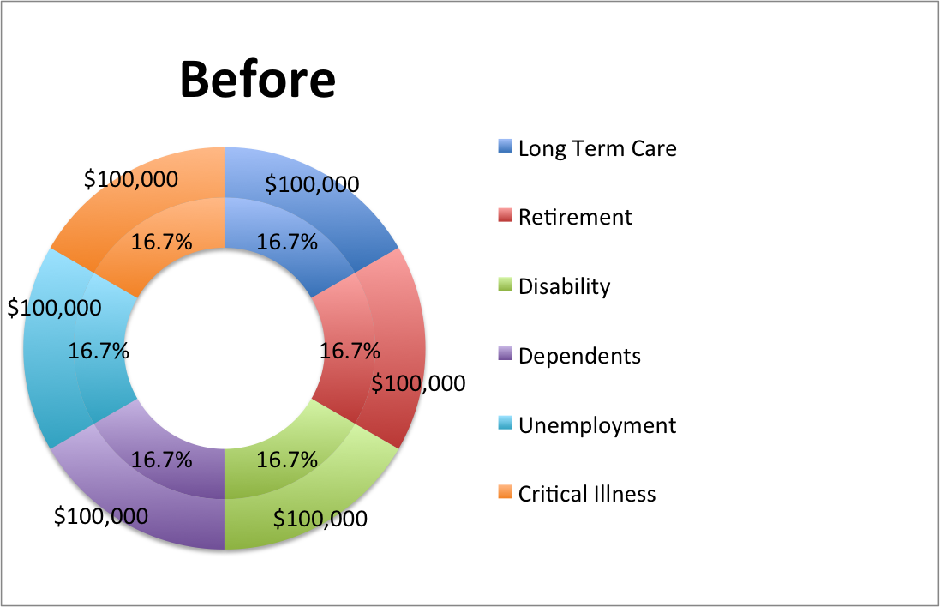
Roger Enrolls In Mass Mutual Complete Coverage
 | Age 25 | Age 35
Coverages | All Active | Exchange critical illness for dependents
Personal Points Program | $0 | $0

Slide 21
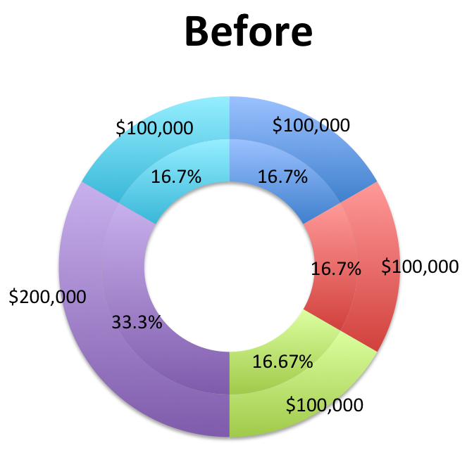
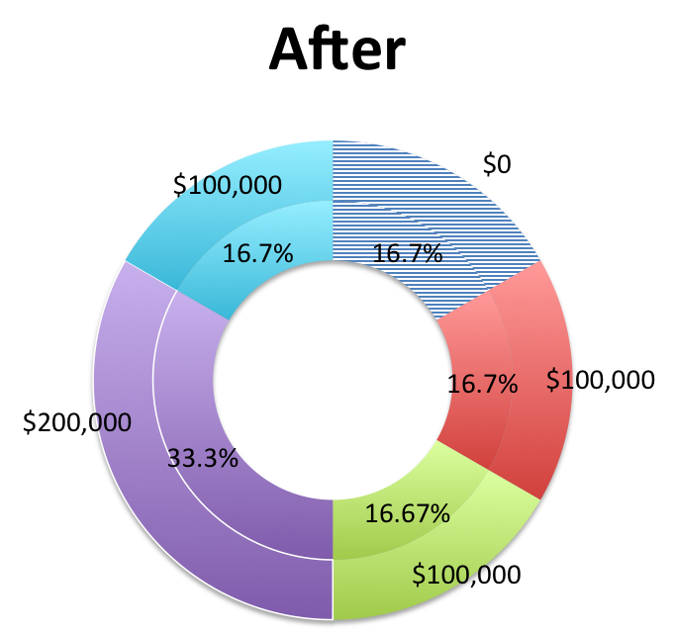
Roger Adjusts His Coverage
 | Age 45
Coverage | no critical illness no unemployment
Personal Points Program | starts accumulating
Notes:
At age 45, Roger feels very confident in the stability of his job. He does not expect to become unemployed anytime soon. Roger, though, is comfortable continuing his $500 yearly payments but would simply want to reduce his unemployment coverage. He decides to decrease his unemployment coverage to $50,000. This coverage given up goes towards his Personal Point Program.
*Pi charts on new coverage amounts, ratios, and corresponding premiums

Slide 22
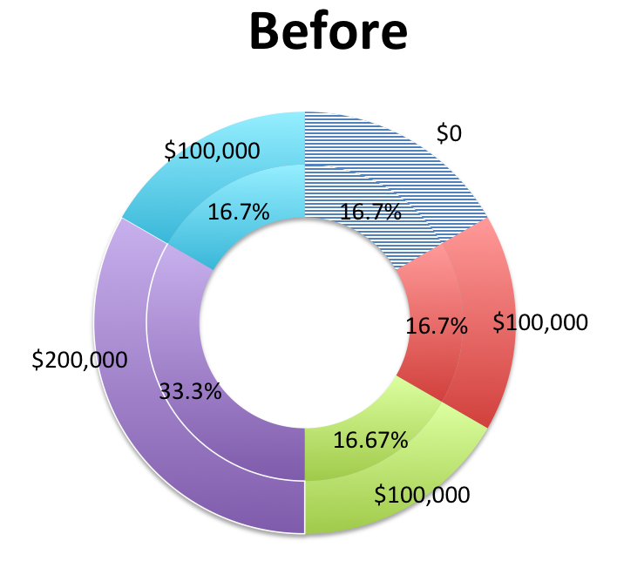
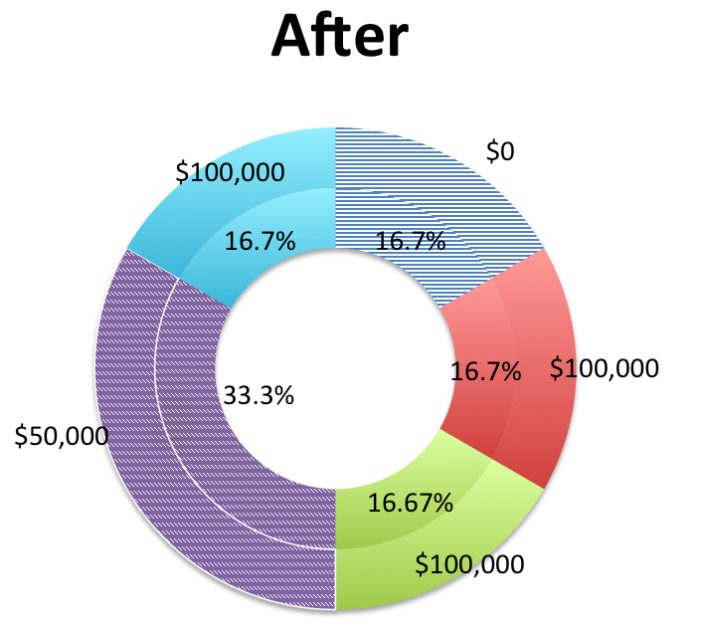
Roger’s Children Establish Independence
 | Age 50
Coverage | Reduced dependents to $50,000
Personal Point Program | $500( current interest rates)
Notes:
Children leave the nest
Reduced dependents 50,000
Inceases Personal Point Program yearly intake by $150

Slide 23
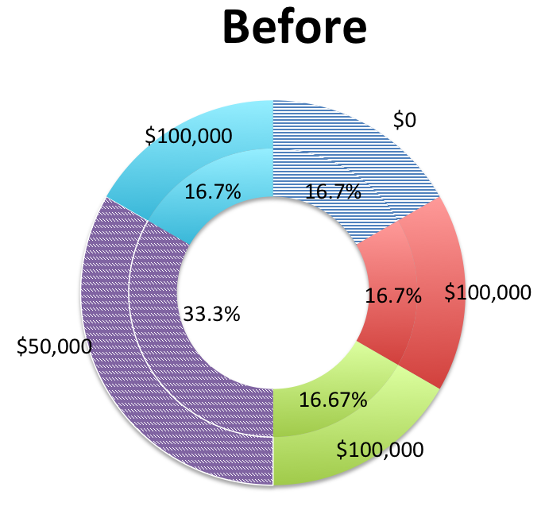
Roger at Age 55
 | Age 55
Coverage | Increases critical illness by 50%
Personal Points Program | $1,750(current interest rate)
Notes:
At age 55, Roger begins to be a little bit concerned about his physical health. He decides to put himself on a soft cap of 300,000 critical illness, sacrificing some over his other coverage, including dependents and unemployment at the same time.

Slide 24
Roger’s Retirement
 | Age 65
Coverage | Begins receiving retirement payoff
Personal Points Program | $1,750(current interest rate)
Notes:
At age 65, Roger retires from his job. He no longer pays money for disability, retirement, nor unemployment. At this point, Roger starts receiving monthly payments of $6,500 as his retirement payoff.
Savings in Personal Point Program chart
Reduces critical illeness to 200,000
Increase long term care to 200,000
Increase dependents to 200,000
Eliminates disability

Slide 25
Roger’s Life through MMCC
At age 80, Roger’s remaining dependent, his wife, Michelle, receives the death benefit payment and obtains access to the accumulated balance in his personal point program.
 | Age 80
Coverage | ceases
Personal Points Program | $1,750(current interest rate)

Slide 26
Conclusion
An Insurance product that is able to provide:
Simplicity
Affordability
Evolve with changing consumer needs

Slide 27
Appendix
"Average Cost of Life Insurance (2017)." ValuePenguin. N.p., n.d. Web. 12 Mar. 2017
Demystifying The Middle Market. Epsilon. Epsilon/LIMRA, May 2014. Web. 14 Mar. 2017.
"Household Healthcare Spending in 2014 : Beyond the Numbers." U.S. Bureau of Labor Statistics. U.S. Bureau of Labor Statistics, 29 Aug. 2016

Slide 28
Thank you
Thank you to Goldenson Center for Actuarial Research and to Mass Mutual for this opportunity.

Slide 29
Questions?

