Slide 1
Simplified/Accelerated Underwriting Model
Goldenson Center for Actuarial Research
Justin Xu, Meng Sun, Chen Xi, Huiqiong Liao, Xueying Zhou
Goldenson Center for Actuarial Research
University of Connecticut

Slide 2
Features of current simplified underwriting models
Based on non-medically underwritten lifestyle information
Includes prescription drug information
Includes Medical Information Bureau (MIB) analysis and mortality risk score from outside consulting firms
Underwriting decision reached in real time
Goldenson Center for Actuarial Research
University of Connecticut

Slide 3
Limitations of current simplified underwriting models
Underwriting decision usually based on some complex predictive model or a risk score
Lack of transparency on the decision-making process
Lack of empirical evidence on effectiveness of underwriting process
Goldenson Center for Actuarial Research
University of Connecticut

Slide 4
Key features of Goldenson Center simplified underwriting model
Based on established Healthy Life Expectancy (HLE) modeling algorithm
Non-medically underwritten lifestyle information translated into adjustment factors to HLE input assumptions – healthy mortality rates, incidence rates of disability, disabled mortality rates
Adjustment factors estimated from research articles and translated into appropriate quantiles of the HLE random variable distribution
Prescription drug information translated into low impact, medium impact and severe impact drugs which are then translated into appropriate adjustment factors to HLE input assumptions
Using a multiplicative factor approach, lifestyle and prescription drug information can be combined to come up with an individual HLE
Goldenson Center for Actuarial Research
University of Connecticut

Slide 5
Decision making process using Goldenson Center model
Individual HLE is compared against the HLE distribution of a “normal’ individual (i.e. adjustment factors are all equal to 1)
If individual HLE falls within some factor times one standard deviation of the mean of the “normal” HLE, then individual qualifies for simplified underwriting
If individual HLE is greater than the factor times one standard deviation of the mean, then the individual qualifies for simplified underwriting with preferred rates
If individual HLE is less than the factor times one standard deviation of the mean, then the individual has to go for full underwriting
The choice of the factor can be determined by a company’s acceptance rate of simplified underwritten business.
Goldenson Center for Actuarial Research
University of Connecticut

Slide 6
Advantages of Goldenson Center model
Fully transparent
Actuarially rigorous
Easy to modify adjustment factors based on emerging mortality experience of simplified underwritten business
Easy decision-making process
Goldenson Center for Actuarial Research
University of Connecticut

Slide 7
Examples of adjustment factors
Individual wellness traits – level of exercise, diet, body-mass index, sleep, alcohol consumption, smoking status
Individual risky traits – credit score, driving history
Individual personal characteristics – gender, level of income, education, marital status
Individual pre-existing conditions – prescription drugs consumed, dosage level and purpose
Goldenson Center for Actuarial Research
University of Connecticut

Slide 8
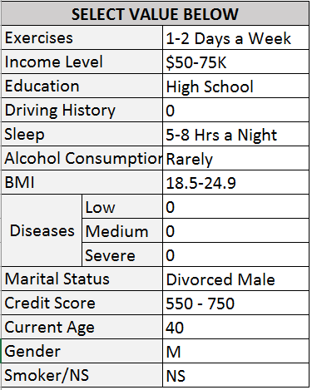
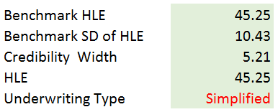
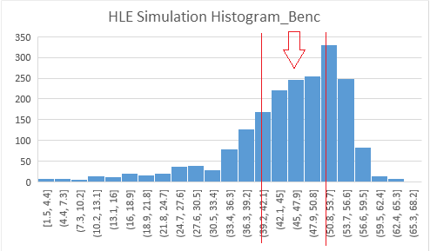
Some illustrative examples – simplified underwriting
Goldenson Center for Actuarial Research
University of Connecticut

Slide 9
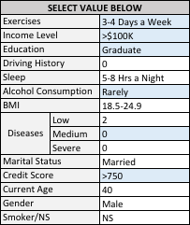
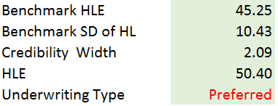
Some illustrative examples – simplified underwriting with preferred rates
Goldenson Center for Actuarial Research
University of Connecticut

Slide 10
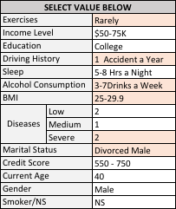
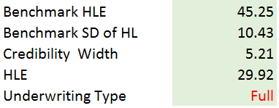
Some illustrative examples – Fails simplified underwriting criteria and requires full underwriting
Goldenson Center for Actuarial Research
University of Connecticut

Slide 11
Client Deliverables
Goldenson Center customized simplified underwriting model based on any specific client needs and underwriting criteria
The underlying Healthy Life Expectancy model, all the adjustment factors, and an Excel/VBA connected to a R model which calculates the decision-making credibility band stochastically and in real-time
Assist client in developing a web-based simplified underwriting model that is available for use by underwriters, agents and brokers
Assist client in setting up a quarterly tracking and monitoring process to test the effectiveness of the Simplified Underwriting model.
Goldenson Center for Actuarial Research
University of Connecticut

Slide 12
Estimated timeline, resources and cost
Project is estimated to take between 10 to 12 weeks to complete using a working team of 5 graduate students.
Project team will be managed by the Director of the Goldenson Center who will have overall responsibility for the project.
In addition, the Director will be assisted by two technical project managers who are PhD students in actuarial science at the University of Connecticut under the supervision of the Director of the Goldenson Center
Estimated cost is a flat amount of $50K
Goldenson Center for Actuarial Research
University of Connecticut

